Slide 1
Hypothesis Testing

Slide 2
Hypothesis Testing
A Hypothesis is a guess or assumption about something which can be tested to see if it is correct or not.
A good hypothesis statement can be tested by
Experiments.
Surveys.

Slide 3
Types of Hypothesis

Slide 4
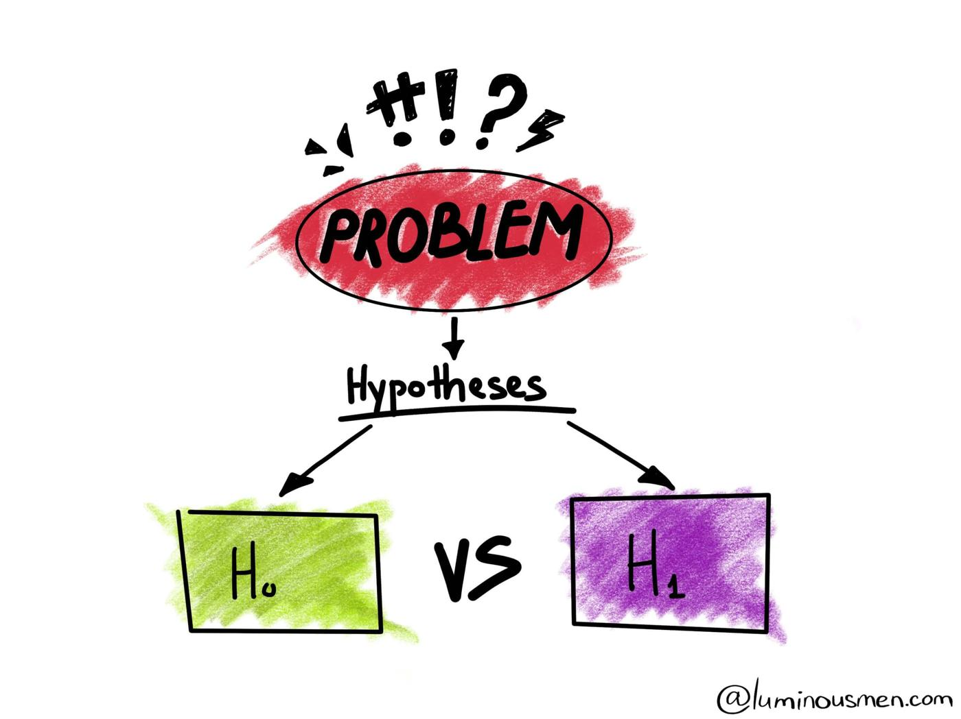
Types of Hypothesis
Null Hypothesis: It is a general statement that there is no difference between two two samples derived from the same general population.
Alternate Hypothesis: It is contrary to the null hypothesis. It is a Statement which is completely opposite to that of Null Hypothesis.

Slide 5
Let’s Take one more Example
Scenario: A Bulb manufacturer claims that the bulb produced by them have an average lifespan of 500 hours.
Null Hypothesis: The average lifespan of bulbs is equal to 500 hours.
Alternate Hypothesis: The average lifespan of bulbs is not equal to 500 hours.

Slide 6
Types of Errors

Slide 7
Types of Errors
Type 1 Error
Type 2 Error
Occurs when we reject a true null hypothesis.
It is denotes by α.
Occurs when we reject a false null hypothesis.
It is denotes by β.

Slide 8
Level of
Significance

Slide 9
Significance Level
A significance level of 0.05 indicates a 5% risk of concluding that a difference exists when there is no actual difference.
The significance level, also denoted as alpha or α, is the probability of rejecting the null hypothesis when it is true.

Slide 10
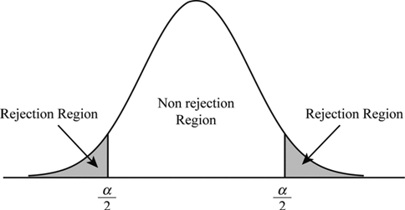
Significance Level

Slide 11
Critical Region

Slide 12
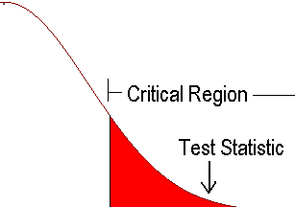
Critical Region
A critical region is an area which gives us statistical significance to reject or fail to reject our claim.

Slide 13
P-value

Slide 14
P-value
P-value is the probability that the null hypothesis is correct.
P-value stands in support of the null hypothesis.
P-value is between 0 and 1.
If P-value < significance level, then we reject the null hypothesis.
If P-value > significance level, then we fail to reject the null hypothesis.

Slide 15
t-Distribution

Slide 16
t-Distribution
Student’s T distribution is a type of probability distribution which is similar to normal distribution with its bell shaped curve but has heavier tails.
It occurs when the sample size is less than 30 and population standard deviation is unknown.

Slide 17
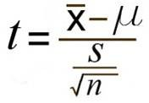
One Sample T test
One Sample T-Test is a statistical procedure used to examine or compare the mean of our sample data to already known population mean.
Formula used for One sample T-test

Slide 18
Degree of Freedom
It is the number of values in the final calculation of a statistic that are free to vary.
We calculate the degree of freedom by the formula “n-1”
where n is the sample size.
If the sample size=20,
then degree of freedom = 20-1 = 19

Slide 19
Two Sampled T Test

Slide 20
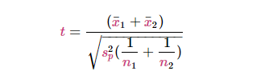
Two Sample T Test
Two Sample T-Test is a statistical procedure used to examine or compare the mean of two separate samples.
Formula for Two Sample Test

Slide 21
Paired Sampled T Test

Slide 22

Paired Sample T Test
Paired Sample T-Test is a statistical procedure for examining or comparing the means of two samples.
It has the situation of before and after.
Formula for Paired Sample Test

Slide 23
T-Test vs Z-Test

Slide 24
T Test vs Z Test
A z-test is a statistical test to determine whether two population means are different when the variances are known.
T-Test :
sample size is less than 30
population standard deviation is unknown.
Z-Test:
sample size is greater than 30
population standard deviation is known.

Slide 25
One Sample
Z-Test

Slide 26
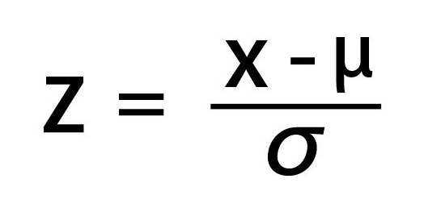
One Sample Z Test
The One Sample z-test is used to test whether the mean of a population is greater than, less than or not equal to a specific value.
x bar is the is the sample mean.
μ is the population mean.
σ is the population standard deviation.

Slide 27
One Sample Z-Test
A z-table is a mathematical table that allows us to know the percentage of values below a z-score value in a standard normal standard deviation.
z-score is positive, then p-value = 1-z-score
z-score is negative. then p-value = z-score
p-value < significance level, then we reject the null hypothesis
p-value > significance level, we fail to reject the null hypothesis

Slide 28
Two Sample
Z-Test

Slide 29
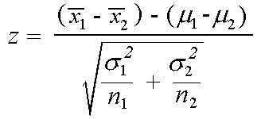
Two Sample Z Test
The Two-Sample Z-test is used to compare the means of two samples to see if it is feasible that they come from the same population. The null hypothesis is: the population means are equal.
Formula for Two sample Z Test

Slide 30
ANOVA - Analysis of Variance

Slide 31
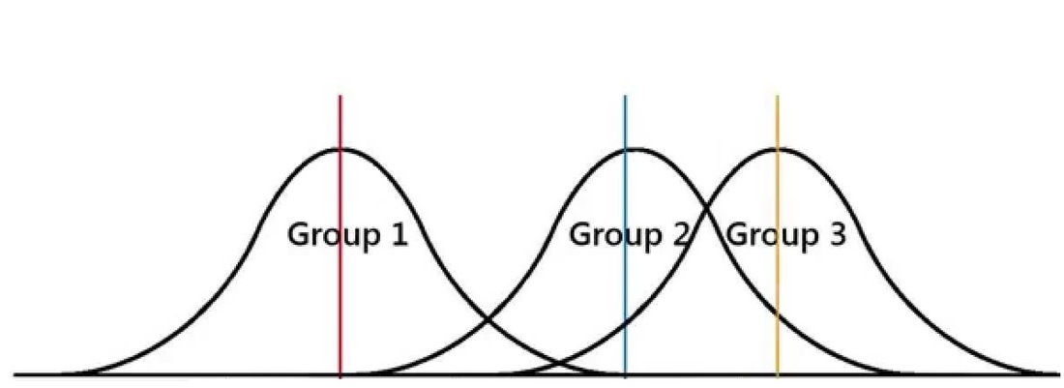
ANOVA - Analysis of Variance
Anova determines whether the means of three or more groups are different.
It uses F-Test to statistically test the equality of means.

Slide 32
ANOVA: Assumptions
Anova assumes independence of observations.
Homogeneity of variances.
Normally distributed observations within groups.
For between groups:
df = no. of groups -1
For within groups:
df = total no. of obs.- number of groups

Slide 33
Chi-Squared Test

Slide 34
Chi-Squared Test
The chi-squared test also known as χ² is used for testing for the relationship between categorical variables.
There are two types of chi-squared test:
Goodness of fit test
chi-squared test of independence

Slide 35
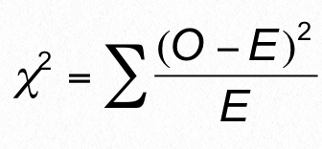
Goodness of fit Test
Formula for Goodness of Fit Test
The chi-squared goodness of fit test is used to test whether the sample data correctly represents the population data or not.

